Slide 1
Streaming Data Analysis
An Overview of Watch Trends, Genres, and Titles

Slide 2
This project explores streaming data to identify patterns in user behavior.
Objectives:
Identify the most watched titles
Analyze watch time by genre
Examine monthly viewing trends

Slide 3
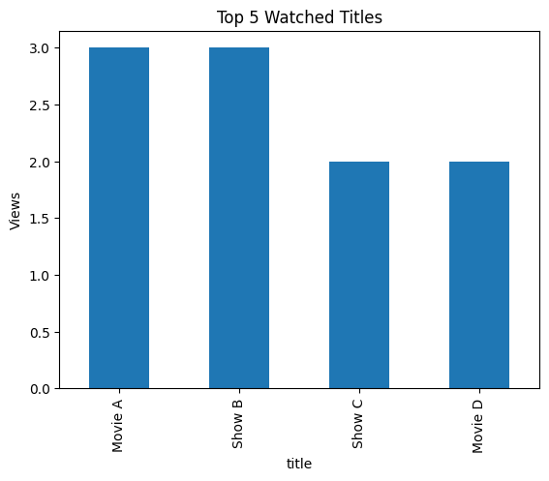
Top 5 Watched Titles
This chart displays the five most frequently watched titles, helping us understand viewer preferences.

Slide 4
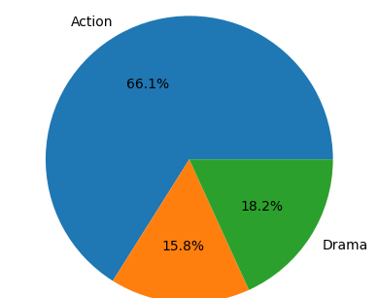
Watch Time by Genre
The pie chart shows how total watch time is distributed across different genres.

Slide 5
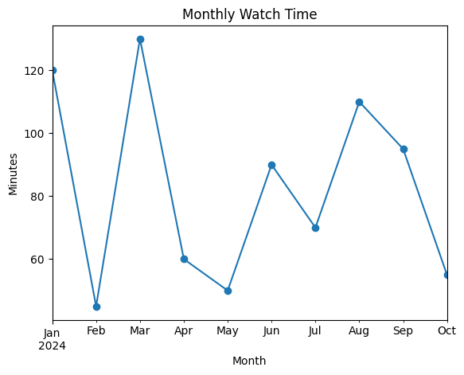
Monthly Watch Time Trend
This line plot illustrates how user watch time varies from month to month.

